Slide 1
GenAI and financial data alert systems
GenAI Insight Overlays
Client: Alvares & Marsal
David Velasquez david.velasquez.24@ucl.ac.uk

Slide 2
Problem Statement
Problem: Executives spend valuable hours navigating dashboards just to extract the specific information relevant to their needs.
Goal: Build an Agentic AI system that runs autonomously and delivers the right insights directly to their inbox — saving time and allowing them to focus on analysis and action, rather than data retrieval.

Slide 3
Technical Complexity: Agent needs to “think” like an analyst
Open-ended task
Multiple potential paths, depth of research depends on previous findings
Context window
Human analysts keep a lot of “meta data” in their own head
Lack of training data for models
Every company is different, and they don’t share their internal analysis publicly!

Slide 4
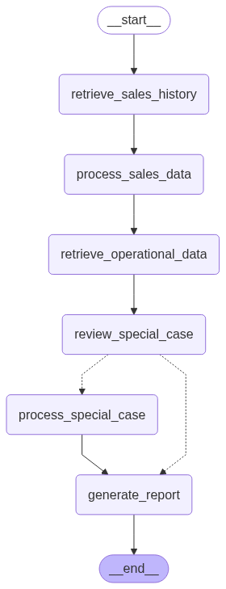
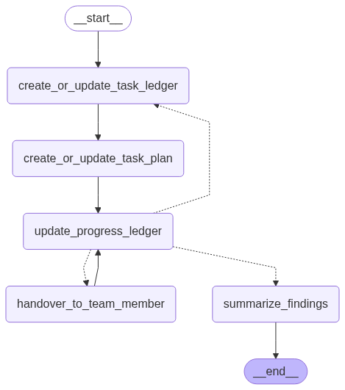
Potential Solution: Context Eng. + MagenticOne
Microsoft Research AI Frontiers, 2024

Slide 5
Thank You!
GitHub: https://github.com/davidve0206/ai-analyst/
LinkedIn: https://www.linkedin.com/in/david-velasquez-v/
Email: david.velasquez.24@ucl.ac.uk

